Slide 1


VISVESVARAYA TECHNOLOGICAL UNIVERSITY
“Jnana Sangama”, Belagavi-590018
PROJECT WORK Phase – II
REVIEW
“IDENTIFYING APPLICATION-LAYER DDoS ATTACKS USING MACHINE LEARNING”
PRESENTED BY
Mahendra Y S[1RR21IS028]
Vishwas J [1RR21IS061]
Sudeep P[1RR21IS055]
Sumith [1RR21IS056]
Supervisor
Dr. T Dharani
Assistant Professor
DEPARTMENT OF INFORMATION SCIENCE & ENGINEERING
RAJARAJESWARI COLLEGE OF ENGINEERING
MYSORE ROAD,BANGALORE – 560074
(An ISO 9001-2019 Certified Institute)

Slide 2
CONTENTS
Abstract
Introduction
Literature survey
Objectives of the project
Architecture of the project
Methodology
Application
Advantages

Slide 3
HARDWARE AND SOFTWARE REQUIREMENTS
SNAPSHOTS
CONCLUSION
REFERENCES

Slide 4
ABSTRACT
Distributed Denial of Service (DDoS) attacks are a growing threat to online services, and various methods have been developed to detect them. However study addressing the impact of freely available DDoS tools on attack escalation.
A machine learning-based detection model with feature selection significantly improves performance, achieving high accuracy (99.9%) and efficiency, a precision score of 96%, a recall score of 98%, and an F1 score of 97%. Moreover, the examination found that by utilizing a deliberate approach for feature selection, our model’s efficacy was massively raised.

Slide 5
INTRODUCTION
A Denial-of-Service (DoS) attack is an attack meant to shut down a machine or network, making it inaccessible to its intended users. DoS attacks accomplish this by flooding the target with traffic, or sending it information that triggers a crash.
Attackers achieve this by sending more traffic & than the target can handle, causing it to fail making it unable to provide service to its normal users.
Examples are email, online banking, websites.
A distributed denial-of-service (DDoS) attack is a DOS attack that uses multiple computers or machine to flood a targeted resource.
Example is Github, a popular online code management service used by millions of developers. This is github attack was a Memcached DDOS attack, so there were no botnets involved.

Slide 6
LITERATURE SURVEY
Sl. No. | Title | Year of Journal | Author | Methodology | Limitation
1. | Intrusion detection using rule-based machine learning algorithms | 2019 | D. Kshirsagar J. M. Shaikh | Rule Based classifier | Rule Generalization Issues, High False Positives, Computational Complexity.
2. | Low-rate DoS attacks, detection, defense, and challenges: A survey | 2020 | W. Zhijun, L. Wenjing, L. Liang, and Y. Meng | Filter Protection Strategy | Lack of Generalization, Complexity in Deployment, Adaptive Attacks.

Slide 7
PROBLEM STATEMENT
Distributed Denial of Service (DDoS) attacks are a growing threat to online services, and various methods have been developed to detect them.
However, past research has mainly focused on identifying attack patterns and types, but there are attacks done by the local freely accessible tools where DDoS attack can be done in a very facile way. Some of the freely accessible tools are Low and slow attack tool, Slow loris tool and R.U.D.Y(are u dead yet?) tool.

Slide 8
OBJECTIVES
To investigate the impact of easily accessible DDoS attack tools on the rise of DDoS attacks.
To propose a machine learning model to detect such attacks with high accuracy and efficiency.
To demonstrate the effectiveness of the model through evaluation metrics like accuracy, precision, recall, and F1 score.
To highlight the importance of feature selection in improving the model's efficiency.

Slide 9
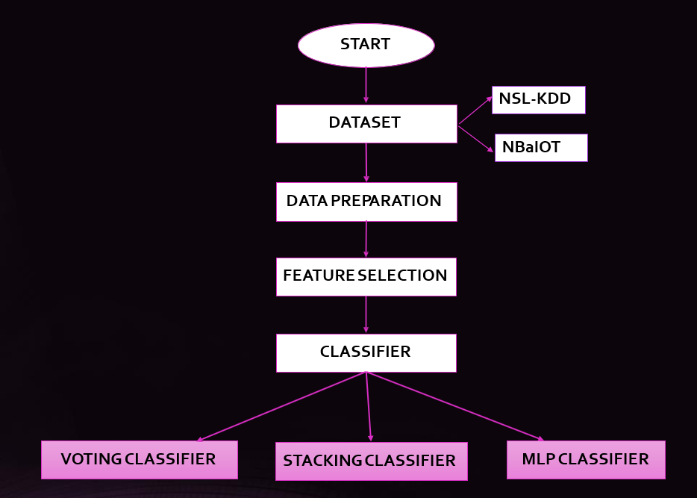
FIG 1: Proposed Block Diagram

Slide 10
METHODOLOGY
According to our project, ML can be utilized to successfully classify DDoS tools into a total of five different categories; four of these classes pertain to DDoS tool attacks, and the remaining class contains innocuous data.
By establishing a fast and reliable technique for selecting the features, we were able to cut the total number of options available in our model from 78 to 11-12.
Our model has a high level of performance across the board, with a 99.2% accuracy, 97.1% precision, 96.1% recall, and 96.6% F1 score when using Adam as the optimizer.
We have achieved this accuracy by the datasets such as NBaIOT [Network based detection of IOT botnet attacks] (which contains Data from 9 Commercial IoT Devices Infected by Mirai and BASHLITE) and NSLKDD (n effective benchmark data set to help researchers compare different intrusion detection methods).

Slide 11
ALGORITMS
. ➢ Decision Tree: • A tree-like structure where data is split based on feature values to classify instances into classes. • Decision trees are interpretable and work well for both categorical and continuous data.
➢ Random Forest: • An ensemble method that builds multiple decision trees and combines their outputs to improve accuracy and reduce overfitting. • It is highly effective for structured data and widely used in agriculture for crop and soil analysis.
➢ Support Vector Machine (SVM): • A powerful algorithm that finds the hyperplane that best separates classes in a high-dimensional • space. • SVMs are effective for small to medium-sized datasets and work well for both linear and nonlinear classification tasks.
➢ K-Nearest Neighbors (KNN): • A simple, instance-based algorithm that classifies data points based on the majority label of their k-nearest neighbors. • It is easy to implement but can be computationally expensive for large datasets.
➢ Naïve Bayes: • A probabilistic classifier based on Bayes' theorem, assuming independence between features. • It is particularly efficient for text classification and works well with small datasets.

Slide 12
Algorithm | Train Accuracy (%) | Test Accuracy (%) | Precision (%) | Recall (%) | F1-Score (%)
Random Forest | 99.94 | 99.24 | 99.33 | 99.24 | 99.24
Decision Tree | - | - | 98.73 | 99.02 | 98.87
KNN | 97.60 | 97.58 | 97.87 | 97.61 | 97.56
SVM | 99.16 | 99.09 | 99.17 | 99.11 | 99.09
Naive Bayes | 99.55 | 99.39 | 99.48 | 99.43 | 99.40

Slide 13
LIMITATIONS
Random Forest: While highly accurate, it can be computationally expensive due to the aggregation of multiple decision trees, making it less efficient for real-time applications.
Decision Tree: Prone to overfitting, especially when the tree grows too deep, leading to reduced generalization on unseen data.
KNN: Performance heavily depends on the choice of k and is computationally intensive for large datasets due to the need to calculate distances for every query.
SVM: Works well with small datasets but struggles with scalability, and choosing the right kernel is often non-trivial.
Naive Bayes: Assumes feature independence, which rarely holds true in real-world datasets, leading to suboptimal predictions.
All algorithms may underperform when faced with highly imbalanced datasets unless explicitly addressed.
Most require careful tuning of hyperparameters and preprocessing, which can be time-consuming and data-dependent.

Slide 14
APPLICATIONS
Improved Attack Pattern Recognition
Faster Detection and Response
Enhanced Security Posture
Real-time Monitoring
Threshold-based Alerting
Evaluation and Fine-tuning
Adaptive Learning

Slide 15
REQUIREMENTS
Hardware Configuration
System: Intel I5.
Hard Disk: 120 GB.
Monitor: 15’’ LED
Input Devices: Keyboard, Mouse
Ram: 8 GB
Software Configuration
Operating System: Windows 64-bit
Technology: Python 3.6
IDE: VS-Code
Tools: Anaconda

Slide 16

SNAPSHOTS
FIG 1: HOME PAGE

Slide 17


Slide 18

FIG 3: STATISTICS SUMMARY

Slide 19


Slide 20
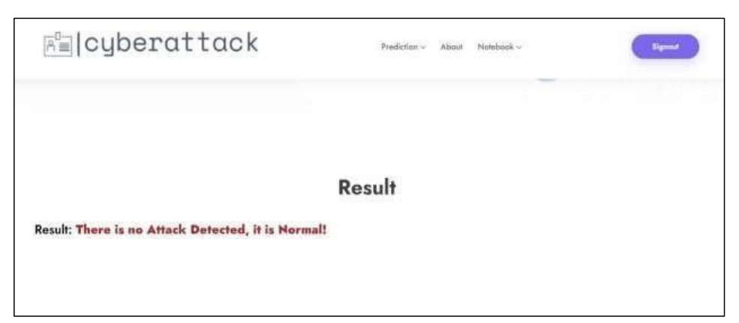

Slide 21
CONCLUSION
Distributed denial of service attacks (DDoS) has the potential to disable essential online services and prevent Users from accessing them. DDoS attack tools are of worry to the defense community for two reasons: (1) they are cheap or even free and easy to find online, and (2) hackers frequently employ them because they can be deployed with little in the way of technological expertise.
According to our research, ML can be utilized to successfully classify DDoS tools into a total of five different categories; four of these classes pertain to DDoS tool attacks, and the remaining class contains innocuous data. By establishing a fast and reliable technique for selecting the features, we were able to cut the total number of options available in our model from 78 to 6. Our model has a high level of performance across the board, with a 99.2% accuracy, 97.1% precision, 96.1% recall, and 96.6% F1 score when using Adam as the optimizer.

Slide 22
REFERENCES
[1] B. B. Gupta, P. Chaudhary, X. Chang, and N. Nedjah, ‘‘Smart defense against distributed denial of service attack in IoT networks using supervised learning classifiers,’’ Comput. Electr. Eng., vol. 98, Mar. 2022, Art. no. 107726.
[2] H. Beitollahi and G. Deconinck, ‘‘An overlay protection layer against denial-of-service attacks,’’ in Proc. IEEE Int. Symp. Parallel Distrib. Process., Apr. 2008, pp. 1–8
[3] O. Yoachimik, ‘‘DDoS attack trends for 2022 Q1,’’ Cloudflare, CA, USA, Tech. Rep., Apr. 2022.
[4] T. Shorey, D. Subbaiah, A. Goyal, A. Sakxena, and A. K. Mishra, ‘‘Performance comparison and analysis of Slowloris, GoldenEye and Xerxes DDoS attack tools,’’ in Proc. Int. Conf. Adv. Comput., Commun. Informat. (ICACCI), Sep. 2018, pp. 318–322.
[5] L. F. Eliyan and R. Di Pietro, ‘‘DoS and DDoS attacks in software defined networks: A survey of existing solutions and research challenges,’’ Future Gener. Comput. Syst., vol. 122, pp. 149–171, Sep. 2021.

